Slide 1
Drivers of HDB Resale Price
TeYang Lau

Slide 2
Contents
HDB Resale Prices Dataset
Other Data Sources / Feature Engineering
Exploratory Data Analysis
Models and Results
Drivers of Resale Price

Slide 3
HDB Resale Prices Dataset
1
Understanding the Data

Slide 4
HDB Resale Prices Dataset
5 Datasets
1990 to Sep 2020
Monthly Transactions
Flat Features
Town
Street Name
Block Number
Storey Range
Flat Model
Flat Type
Floor Area
Lease Commence Date
Remaining Lease
Resale Price
Nominal Price
826,581 transactions
Notes:
remaining_lease has lots of NAs. They are only available after 2015 sales onwards

Slide 5
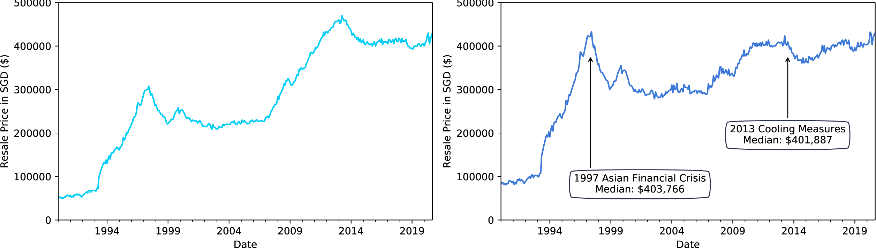
Median HDB Resale Prices Over the Years
Unadjusted for Inflation
Adjusted for Inflation to 2019 SGD
Adjust using Consumer Price Index for Housing and Utilities (singstat.gov.sg)
Notes:
resale_price / cpi * 100

Slide 6
Other Data Sources
2
Feature Engineering

Slide 7
Process
Names of amenities were downloaded/scraped from Data.gov.sg and Wikipedia
Get coordinates using OneMap.sg API
Use geopy package to get distance between 2 locations
Compute nearest distance to each amenity
Compute number of amenities in 2km radius

Slide 8
Nearest Amenities Distance & Number in 2km Radius
Flat | Nearest Primary School | Nearest School Distance | Num School | Nearest Hawker | Nearest Hawker Distance | Nearest Mall | Nearest Mall Distance | Nearest MRT | Nearest MRT Distance | Distance From Dhoby
481 SEMBAWANG DR | Canberra Primary School | 0.23 | 7 | Chong Pang Market & Food Centre | 2.75 | Sun Plaza | 0.71 | SEMBAWANG MRT STATION | 0.70 | 17.32
3A UPP BOON KENG RD | Bendemeer Primary School | 1.21 | 6 | North Bridge Road Market & Food Centre | 1.25 | Aperia | 1.02 | KALLANG MRT STATION | 0.28 | 3.41
126 SERANGOON NTH AVE 1 | Zhonghua Primary School | 0.69 | 6 | Chomp Chomp Food Centre | 0.62 | Hougang 1 | 1.35 | KOVAN MRT STATION | 1.60 | 7.95
536 UPP CROSS ST | Cantonment Primary School | 1.22 | 2 | Market Street Food Centre | 0.04 | People's Park Centre | 0.20 | CHINATOWN MRT STATION | 0.13 | 1.58

Slide 9
Exploratory Data Analysis
3
By Each Feature

Slide 10
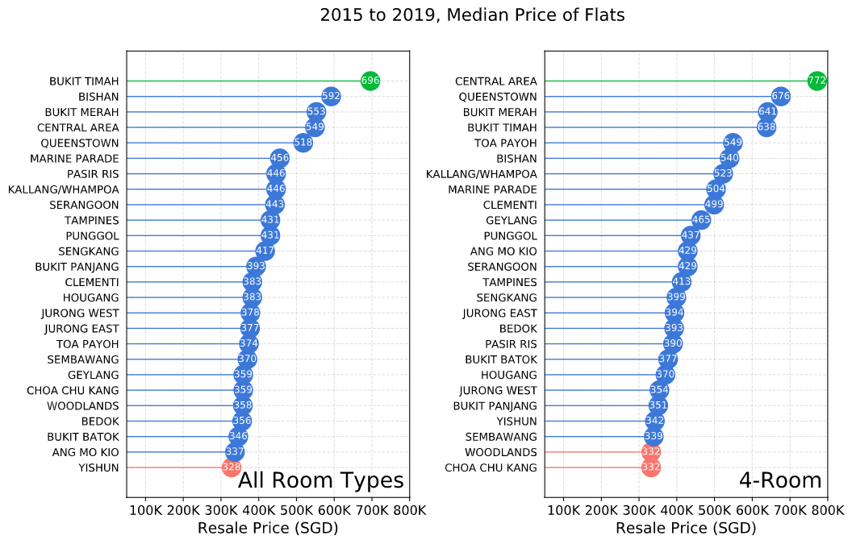
Resale Price by Town

Slide 11
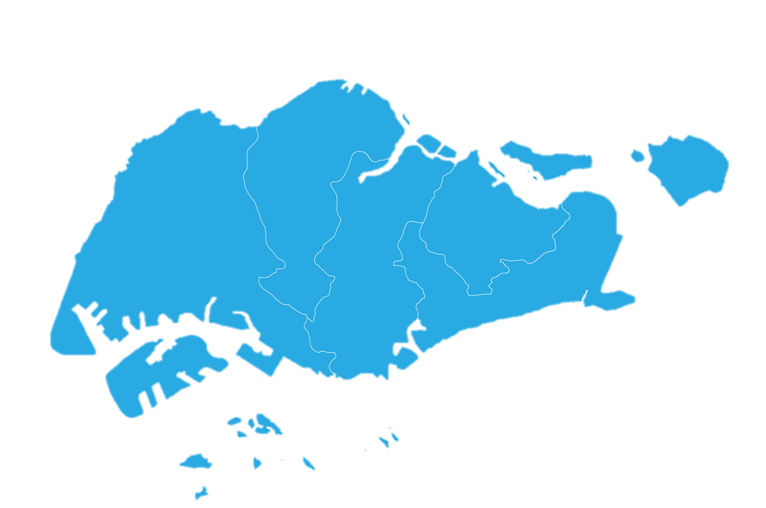
North
SGD 351,798
North-East
SGD 410, 850
West
SGD 371,119
East
SGD 413,631
Central
SGD 485,659

Slide 12
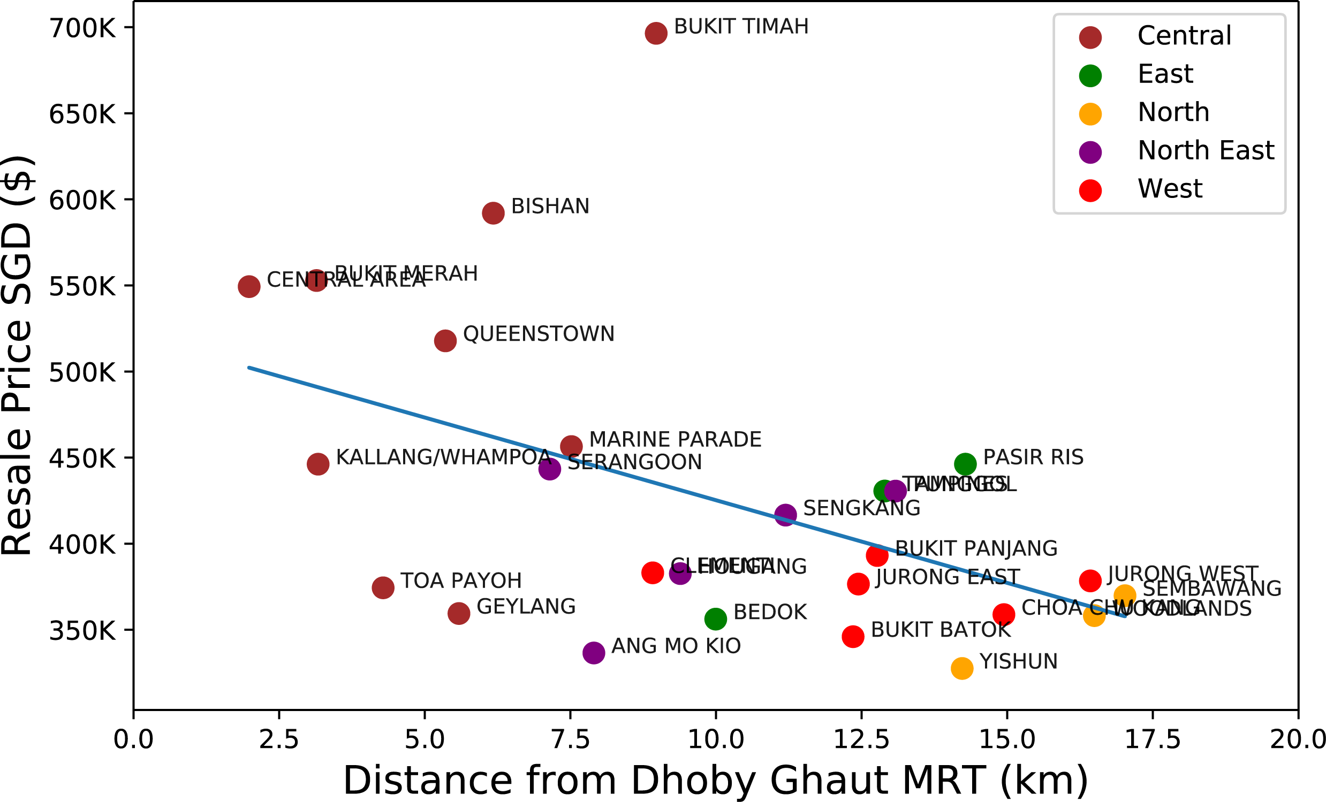
Resale Price by Distance From Dhoby Ghaut MRT

Slide 13
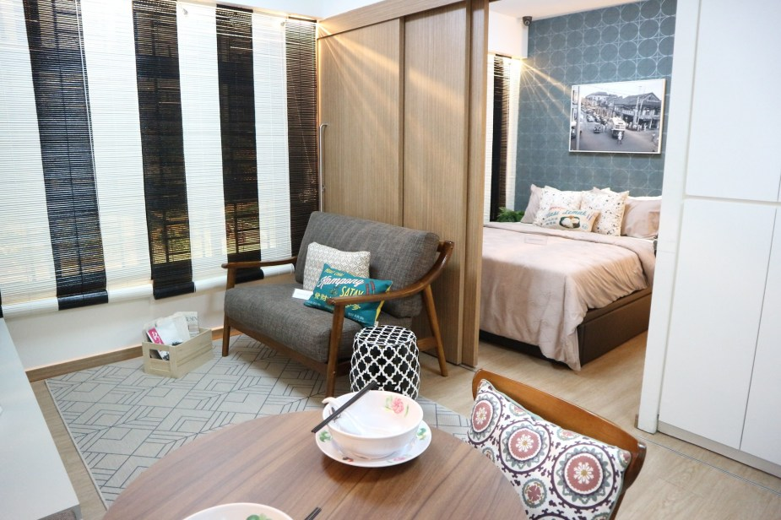
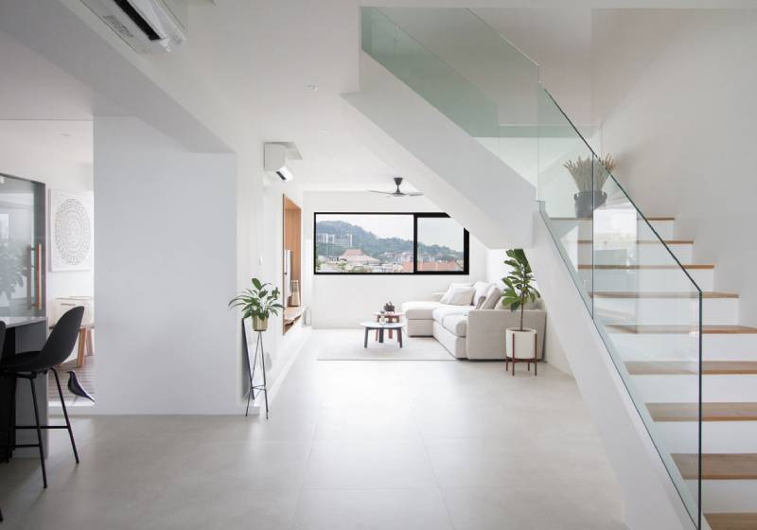
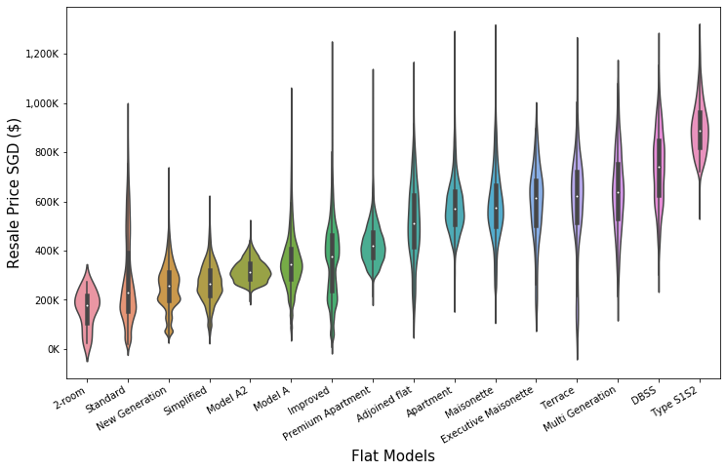
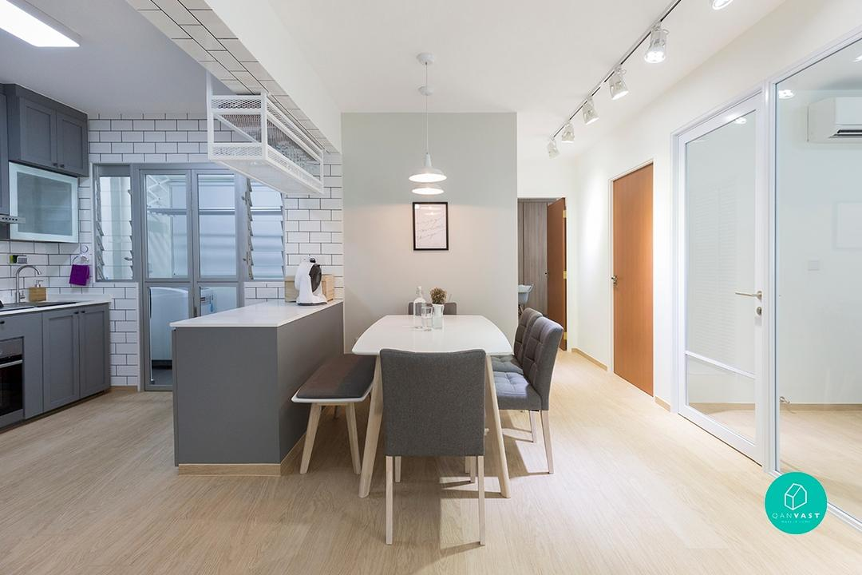
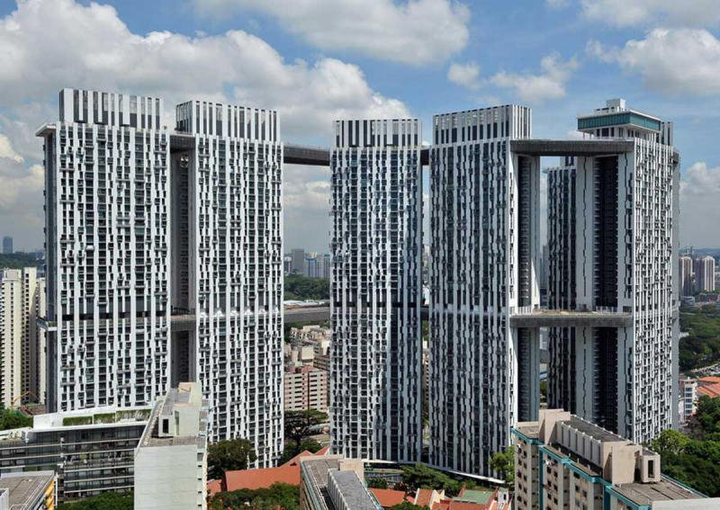
Resale Price by Flat Model
2 Room
Maisonette
Model A
Type S1S2
Model A; Standard; New Generation
Apartment; Maisonette; Special

Slide 14
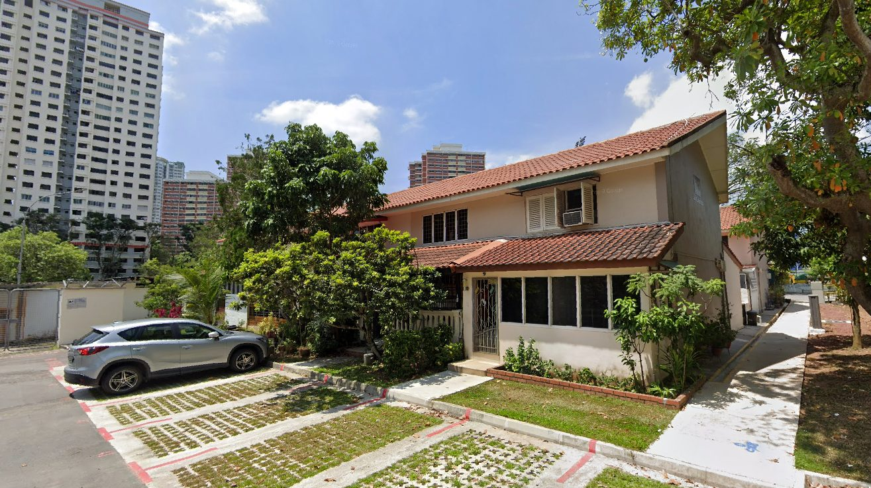
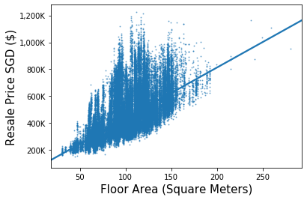
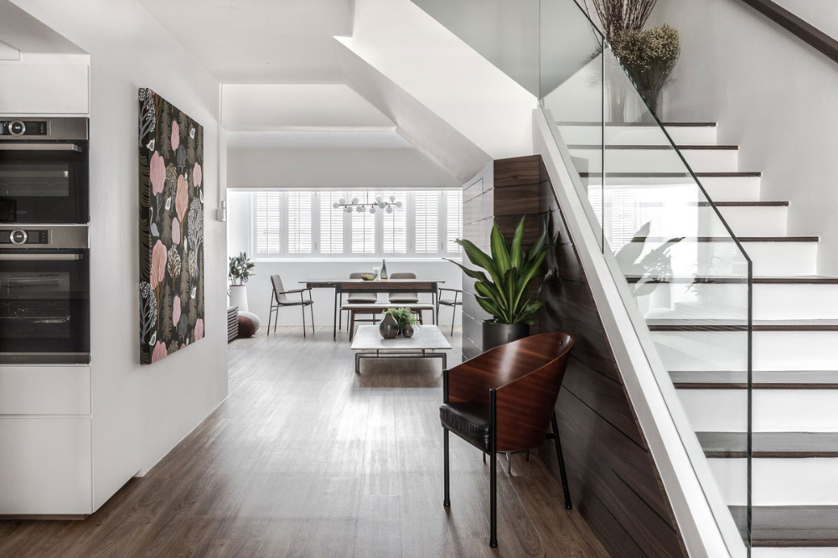
Resale Price by Floor Area

Slide 15
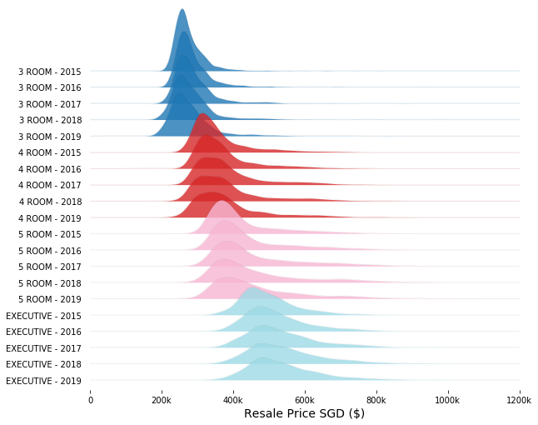
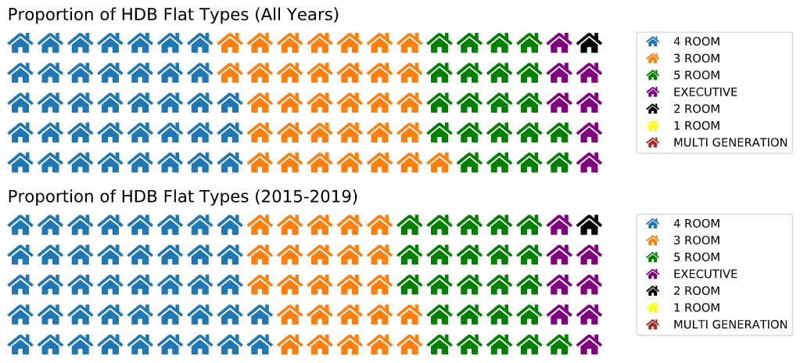
Resale Price by Flat Type

Slide 16
Model and Results
4
Linear Regression
Random Forest

Slide 17
Data Prepreration
Multicollinearity
Label Encoding
Storey Range
Flat Type
Dummy Encoding
Flat Model (baseline – Standard)
Region (baseline – Central)
Feature Scaling
Using StandardScaler from SKLearn on all continuous features
Features | VIF Before | VIF After
Lease Commence Date | 44562 | 53
Year | 44064 | -
Floor Area | 20 | 19
Nearest Hawker Distance | 11 | 8
Nearest Park Distance | 6 | 6

Slide 18
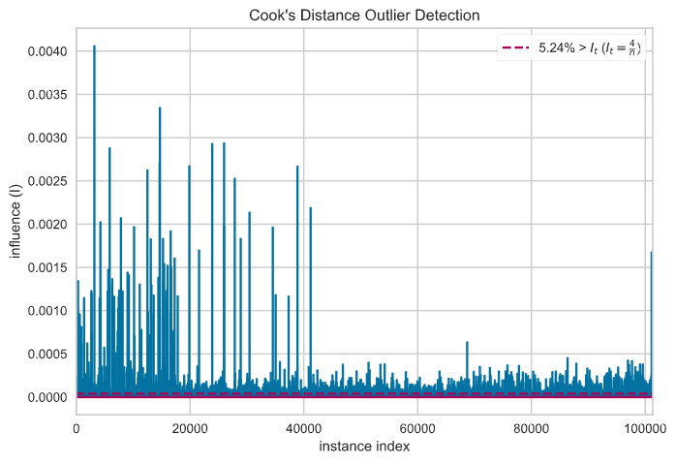
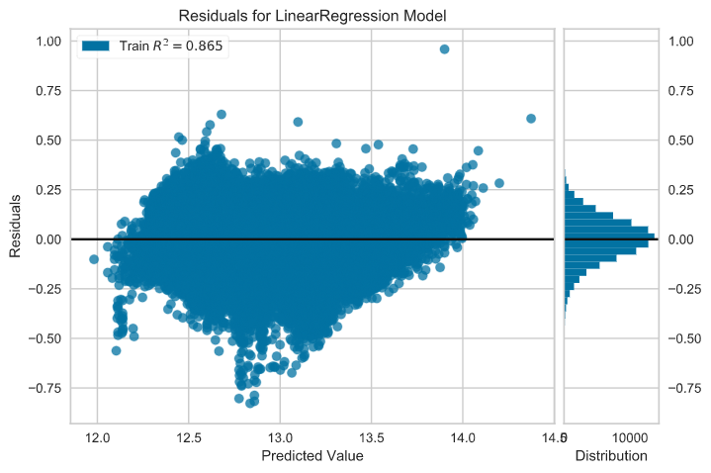
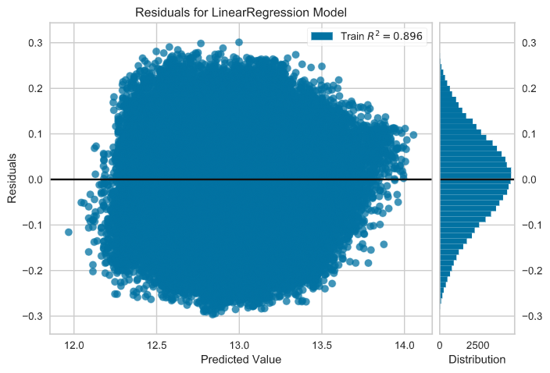
Data Prepreration — Outlier Detection
Cook’s Distance
Before outlier removal
After outlier removal
Notes:
Threshold = 4/n

Slide 19
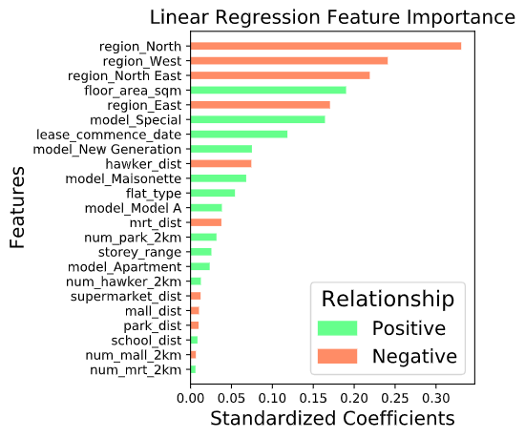
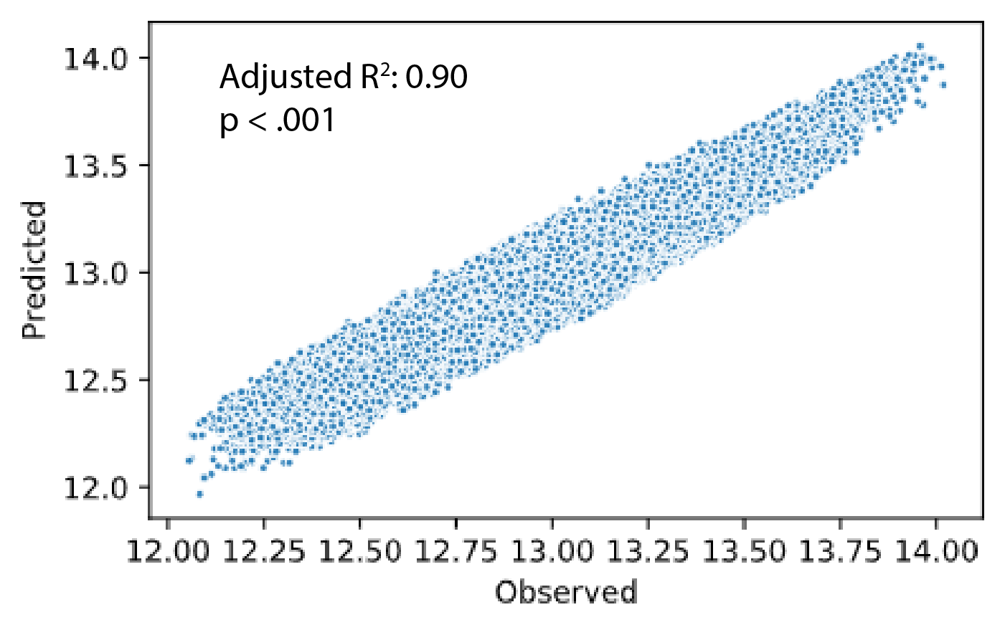
Linear Regression
OLS Regression
23 Features
Statsmodels package

Slide 20
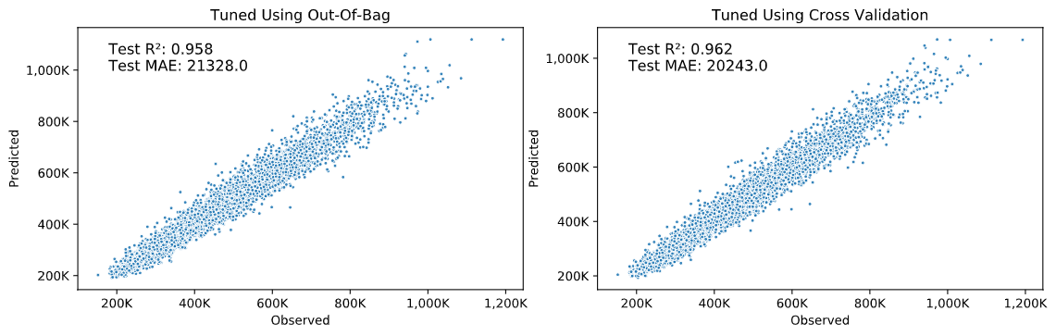
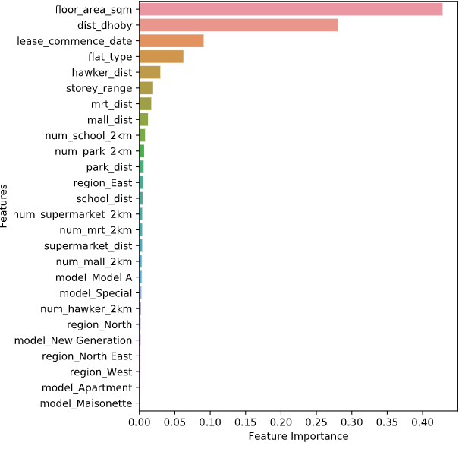
Random Forest
Random Forest Feature Importance
Random Forest Regression
26 Features
SKLearn package
Train Test — 9:1
Out-Of-Bag (R²: 0.957)
Grid Search Cross Validation
(R²: 0.961)
Notes:
9:1 train-test ratio (90k : 10k)
Out-of-bag
Gridsearch CV

Slide 21
SHAP Values
Predicted Low Resale Price
Predicted Medium Resale Price
Predicted High Resale Price

Slide 22
Conclusion
Resale Price
Increasing trend
Focusing on past 5 years
Better able to look at drivers
2 Models
Linear & Non-linear
R² >= 0.9
~ $20,000 MAE
Other Factors
Number of BTOs
Government Policies
Condition of House
Flat Features
Floor Area
Number of Rooms
Lease
Lease commencement date that starts more recently fetch higher resale prices
Location
Region — Central Area
Distance from Dhoby Ghaut
Distance from Hawker Centers

